Slide 1



Meaningful Yelp Data for Business Units & Users
Team: Attention Please! Chen Pengyao / LiYuan / Yumi Shin / ZhaoWei

Slide 2




Contents
Datasets
Design Implement
Analytical Task - Part 1 Business
Analytical Task - Part 2 User
Conclusion

Slide 3
Data Structure Overview
Business.json
Basic: Business_id, Name, Postal_code, Stars
Location: State, City, Address, Latitude, Longtitude
Open Hour: Open_state, Open_time
Menu Category: Taste, Type
Dataset: Yelp (website and mobile app)
Coverage: 11 metropolitan areas in
4 countries
Volume: 174,000 businesses,
5,200,000 user reviews
Used Dataset: Business, Reviews, Check-in
Reviews.json
Basic: Business_id, Review_id, user_id, Stars
Comment: Date, Text
Checkin.json
Check-in: Business_id, Date

Slide 4



Design Implement Method
Word
Cloud
Bi-Directional
Histogram
Heatmap
Map
Radar
Chart
Parallel
Coordinates
River
Metaphor

Slide 5
Analytical Task – Business Gain insight into customers’ visit pattern and review
Analyze the half-monthly emotional opinions from customers for stores during the past 1.5years
Bi-directional histogram
Business
Analyze the different stars number in the past 1.5years, and the corresponding comments.
River metaphor and Wordcloud
Analyze the relationship between the dates and the crowdedness
Calendar Heatmap

Slide 6
Data Processing – Date and Check-in
checkin.json in Yelp dataset
Date-value pairs (Date & Check-in)
{
"business_id": "tnhfDv5Il8EaGSXZGiuQGg"
"date":
"2016-04-26 19:49:16,
2016-08-30 18:36:57,
2016-10-15 02:45:18,
2016-11-18 01:54:50,
2017-04-20 18:39:06,
2017-05-03 17:58:02"
…...
}
{
"business_id": "tnhfDv5Il8EaGSXZGiuQGg"
"data":
[ ["2018-01-01", 217],
["2018-01-02", 106],
["2018-01-03", 245],
["2018-01-04", 157],
["2018-01-05", 114],
["2018-01-06", 41],
…...]
}

Slide 7
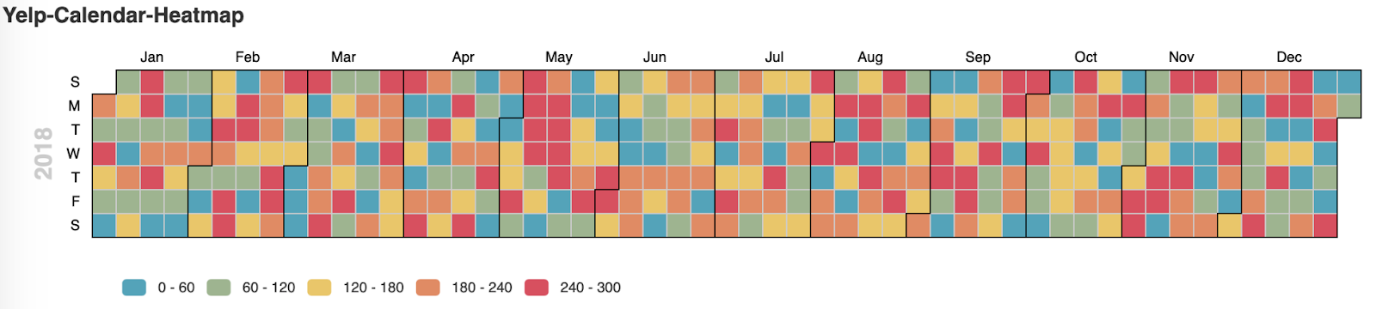

Sentiment Analysis of Crowdedness -1
Encoding Scheme:
Color: five color represents different level of crowdedness from 0 to 300
Shape: one square represents one day in a year
Dimension: x-axis represents month, y-axis represents Sunday to Saturday
Findings:
The number of check-in in one day of a year varies
Crowdedness focuses on Saturday and Sunday
When holidays come, the checkin will rise

Slide 8
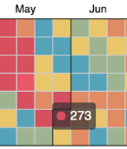
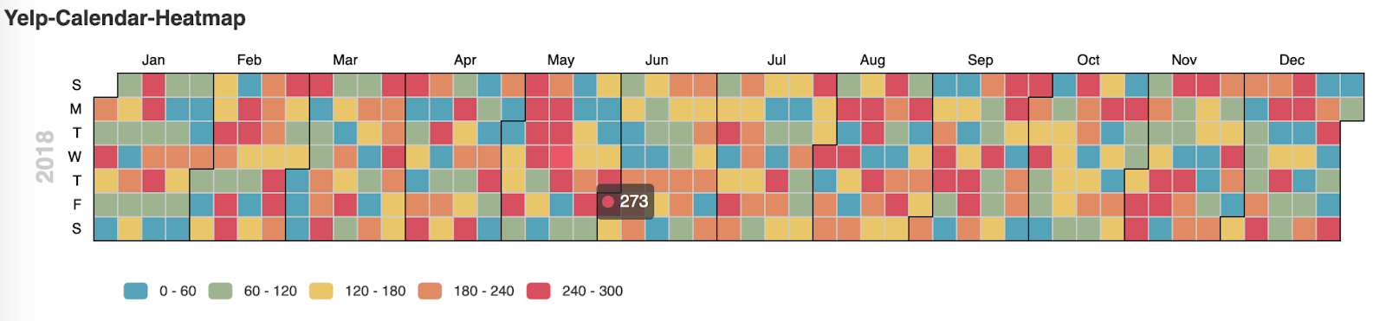

Sentiment Analysis of Crowdedness -2
The number of checkin in May 4th Tuesday is 273.
Interactive usage:
select one specific day to know the number of checkin in that day
Remark:
May 4th Tuesday has been chosen

Slide 9
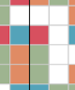
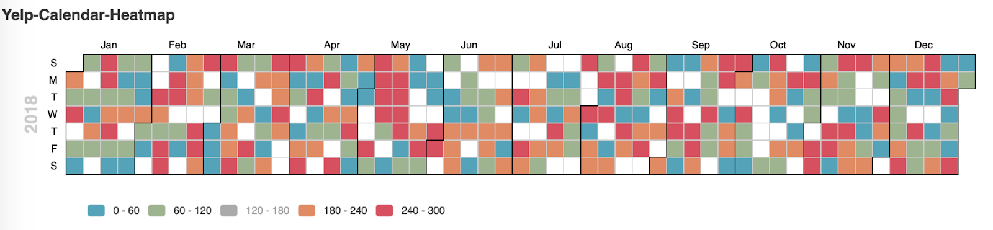

Sentiment Analysis of Crowdedness -3
The distribution of checkin between 120 to 180 has been set to white square.
Interactive usage:
select one specific day to know the number of checkin in that day
Remark:
Crowd degree of 120-180 level is been chosen

Slide 10
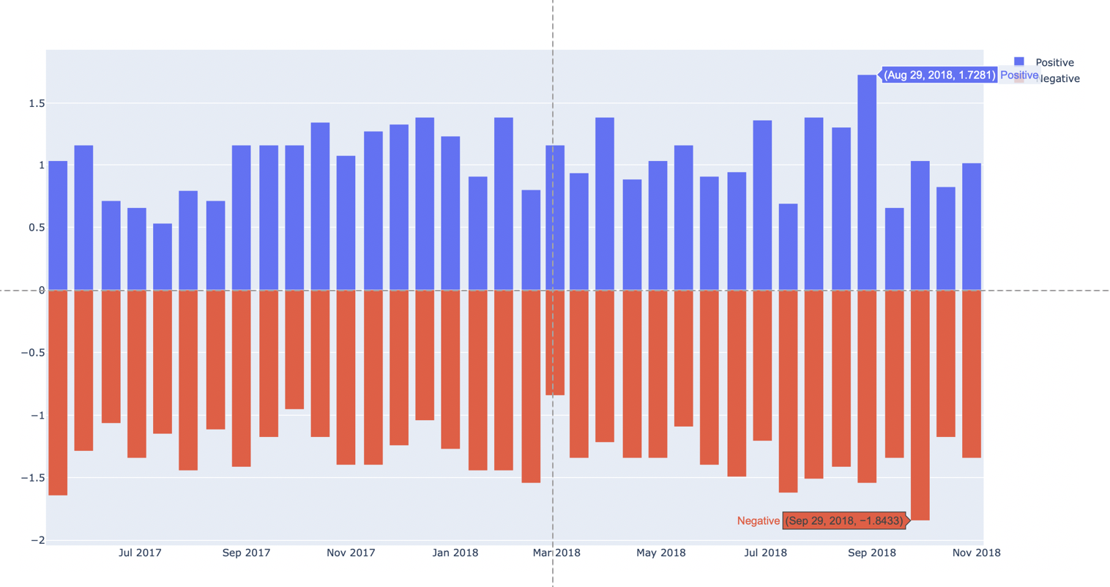
Sentiment Analysis of Rating - 1
Encoding Scheme:
Color: positive and negative stars
Length: the values for 15days on positive and negative
Findings:
Negative opinion is more than Positive but it is not bad as a whole look.
2018.08.14 - 2018.08.29 had the most positive opinion; 2018.09.14 - 2018.09.29 had the most negative opinion
Making a review for these good / bad performance day.
Half-monthly emotional opinion for store1

Slide 11
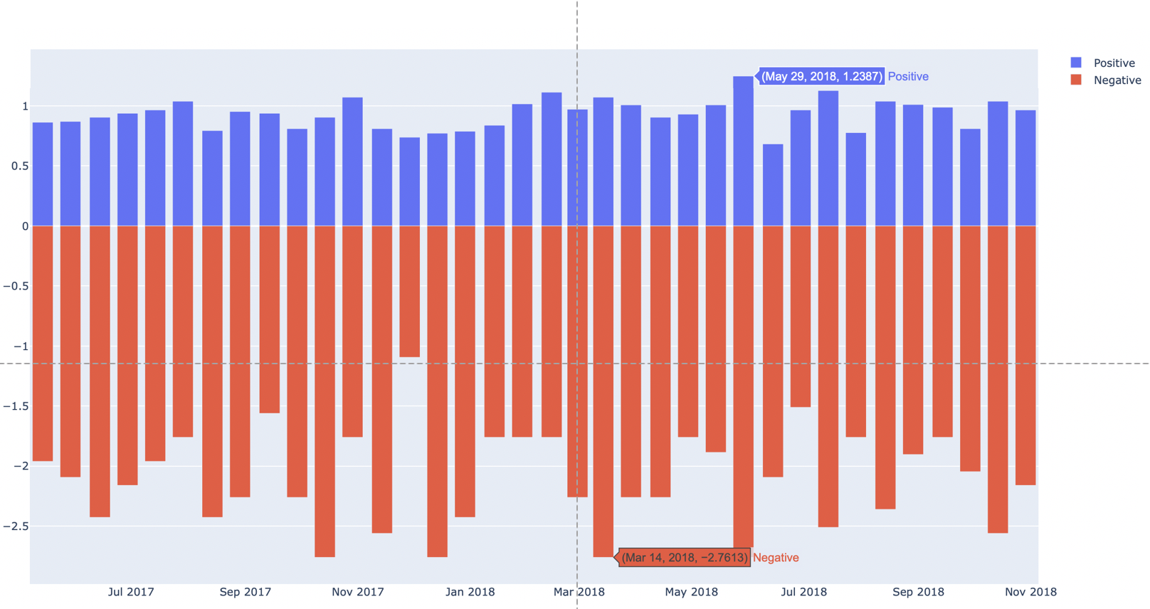
Sentiment Analysis of Rating - 2
Findings:
Negative opinion is always more than Positive.
2018.05.14 - 2018.05.29 had the most positive opinion; 2018.03.14 - 2018.03.29 had the most negative opinion
Making a review for these good / bad performance day.

Slide 12

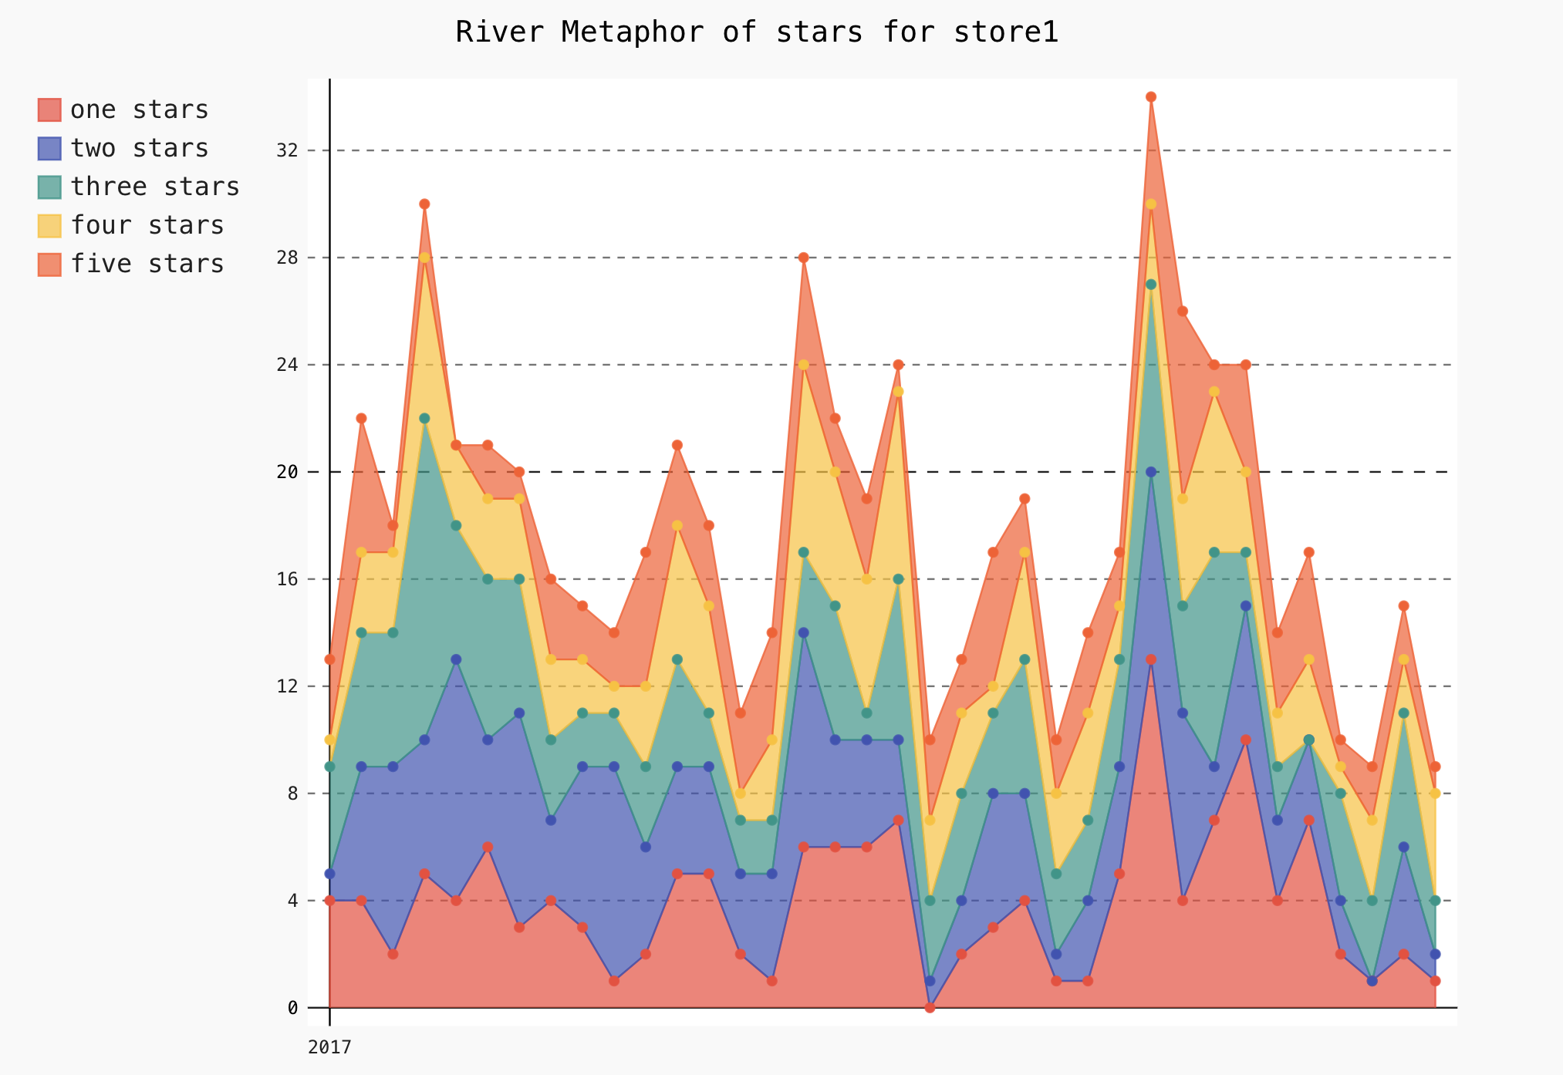
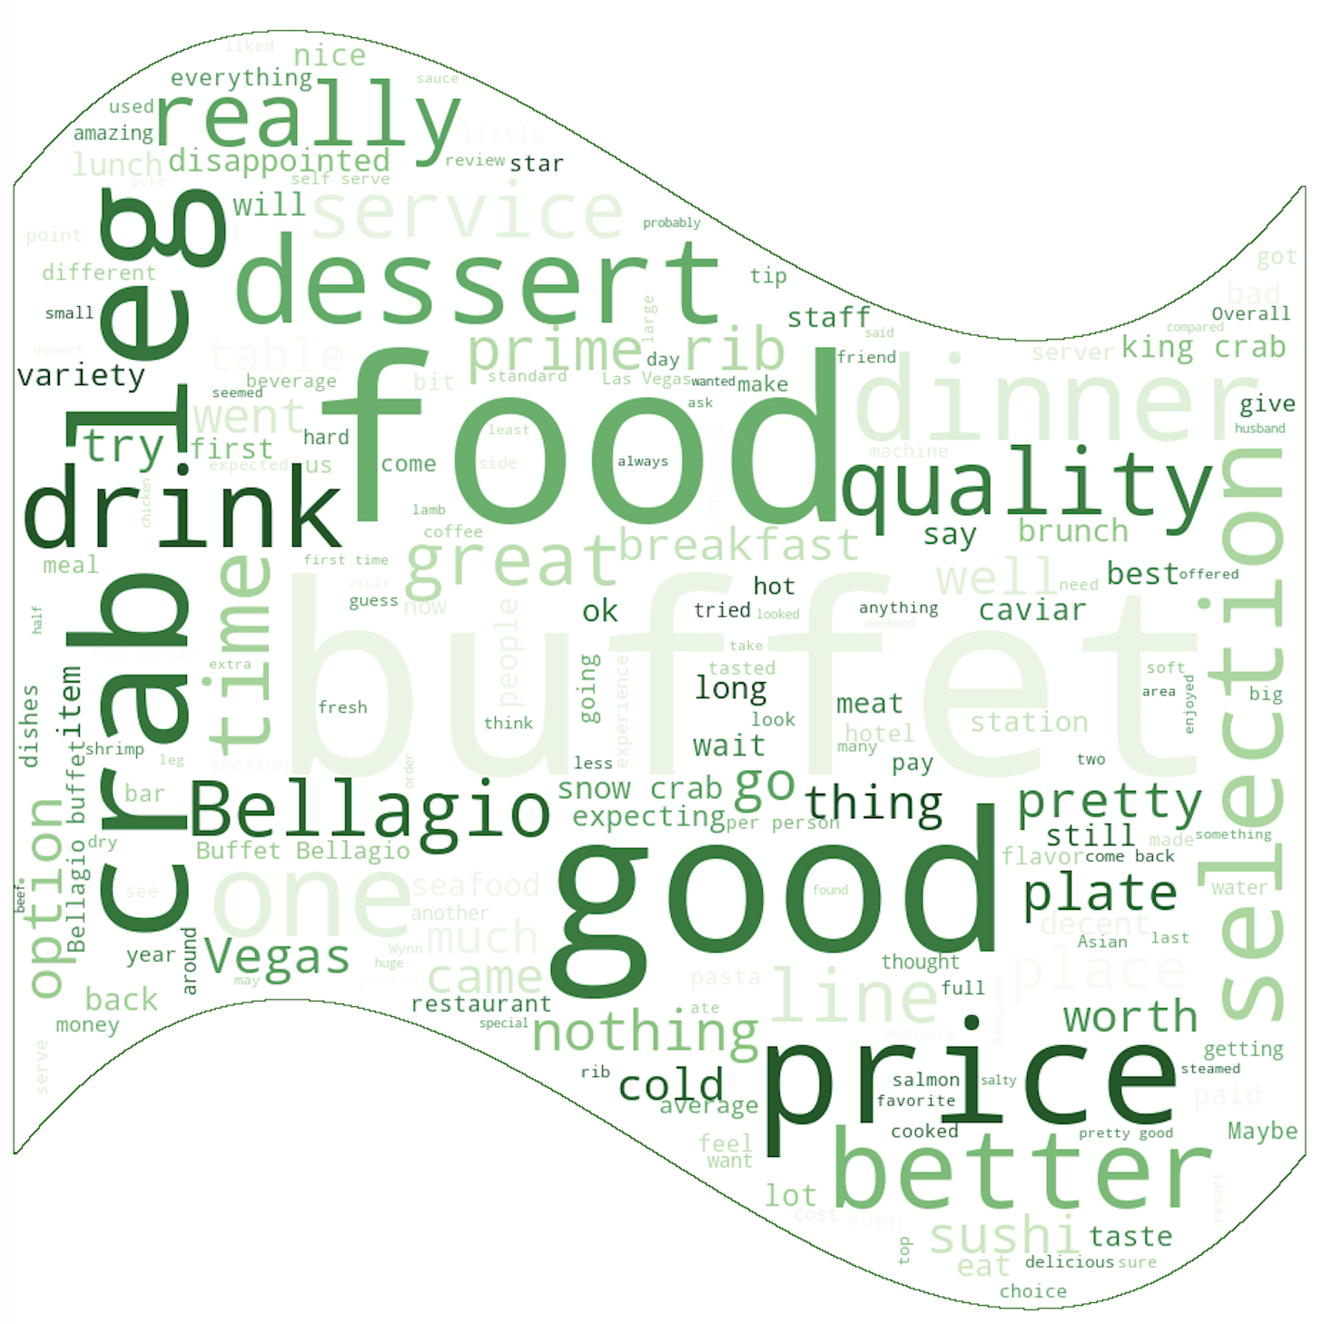
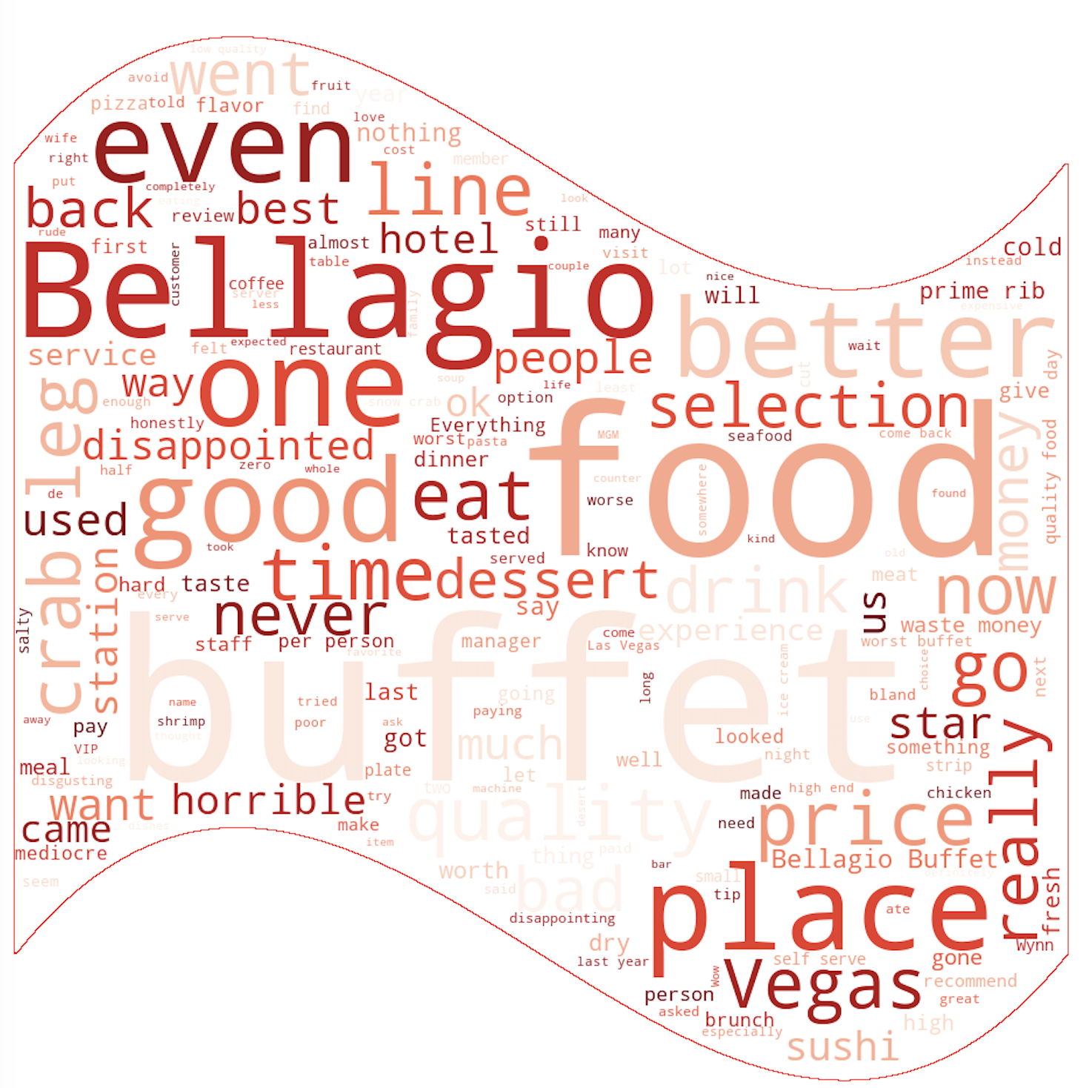
Customer Rating Review - 1
Encoding Scheme:
Color: positive and negative stars
Length: the values for 15days on positive and negative
Could word: the main text from customers‘ comments

Slide 13
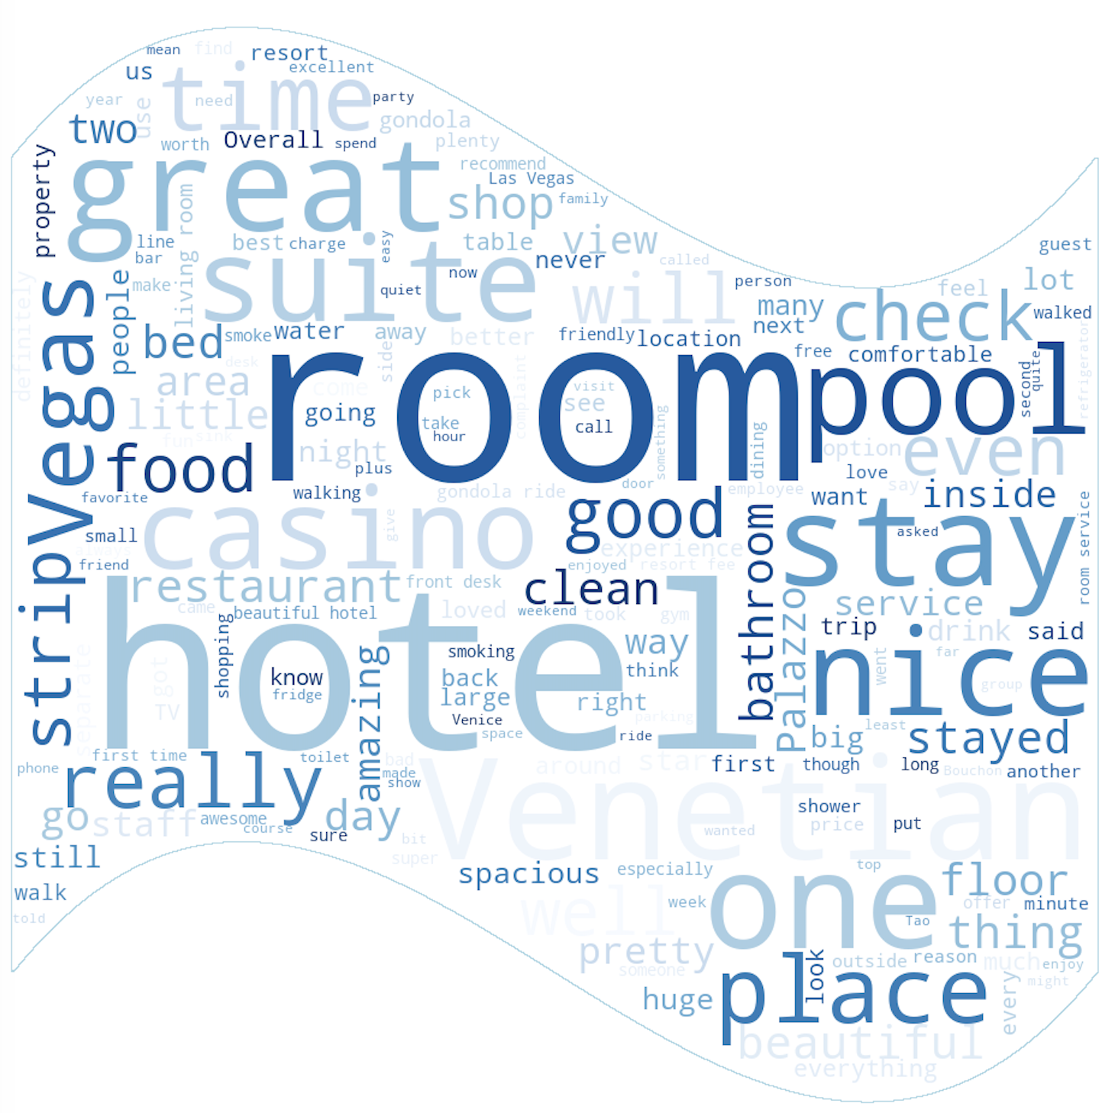
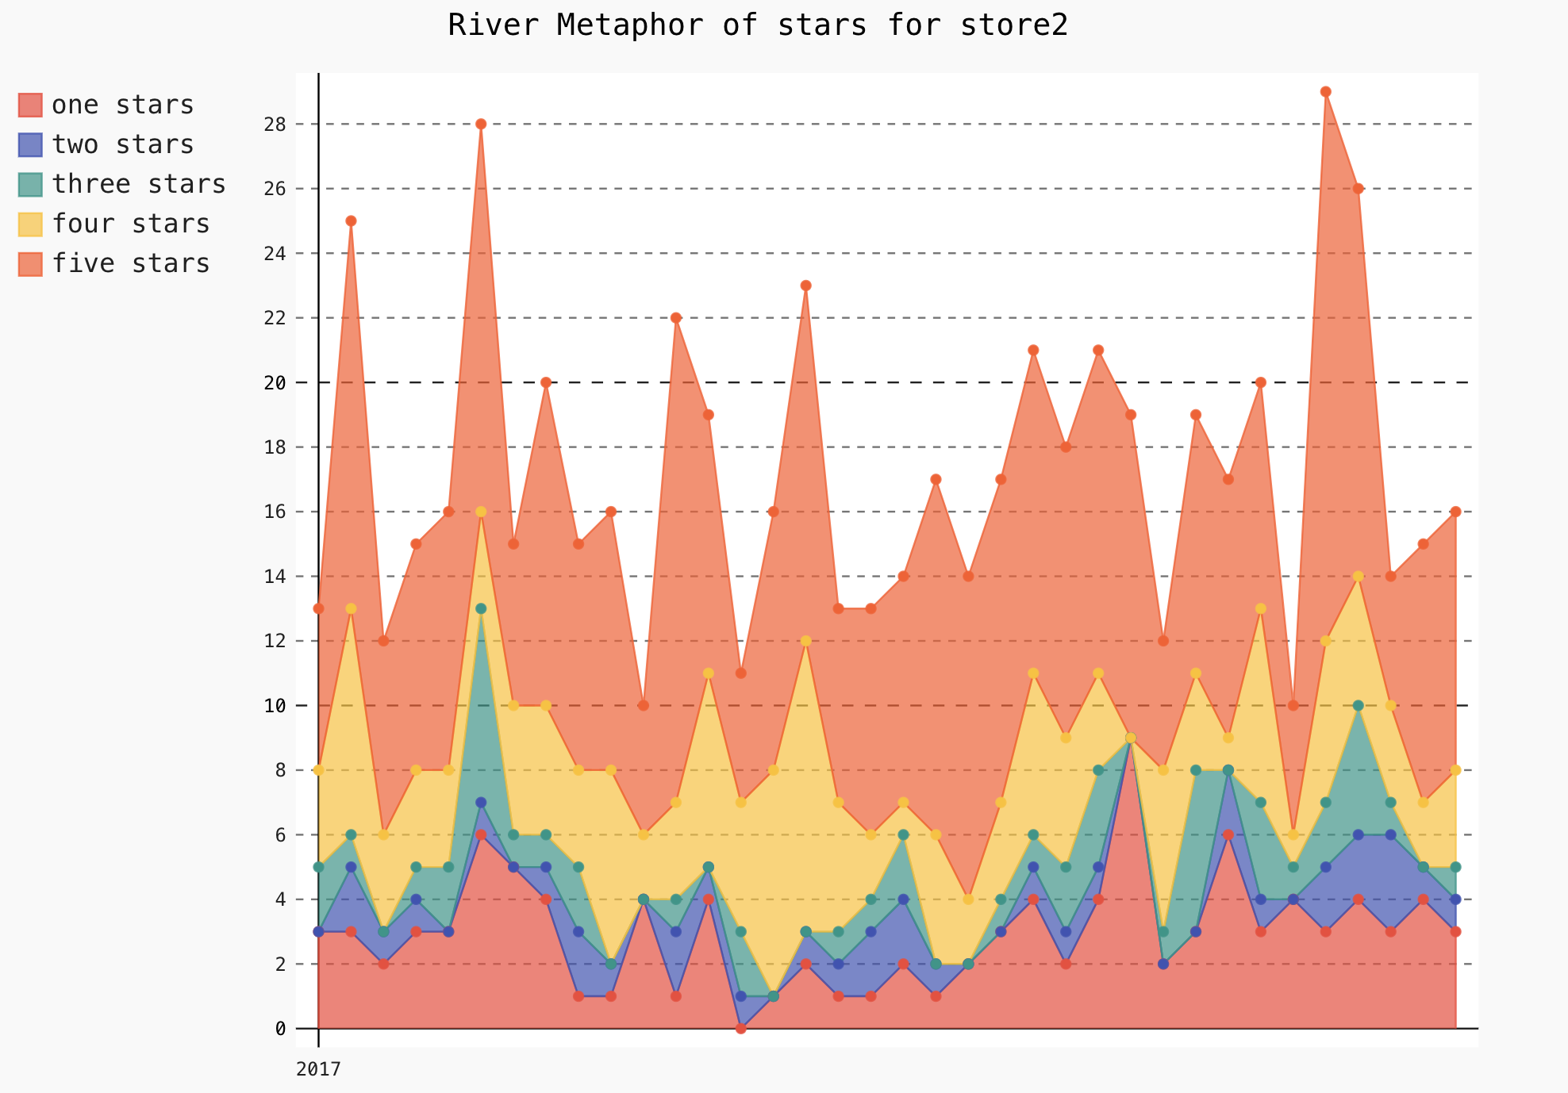
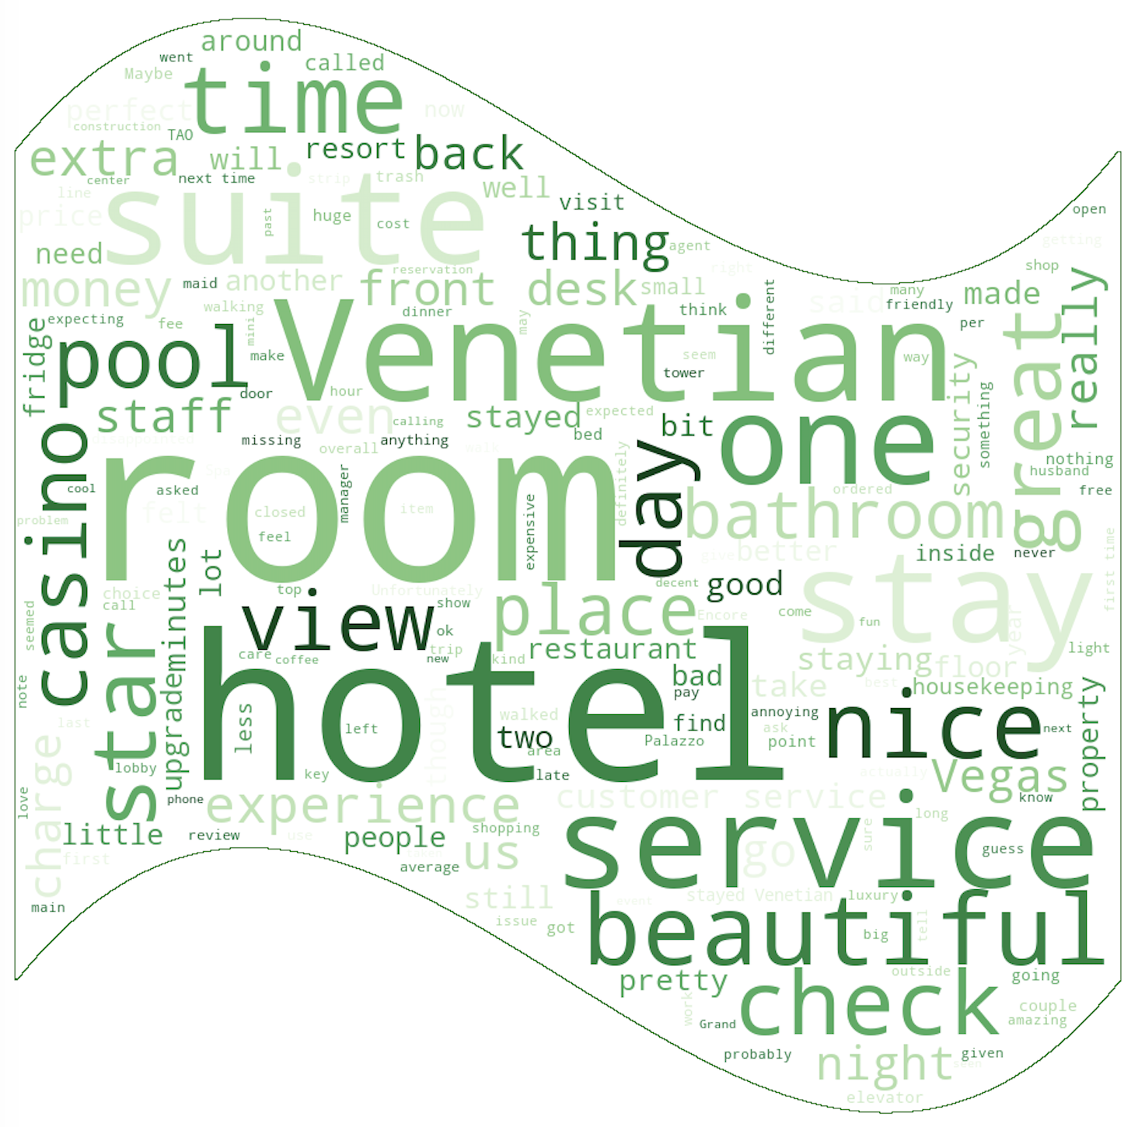
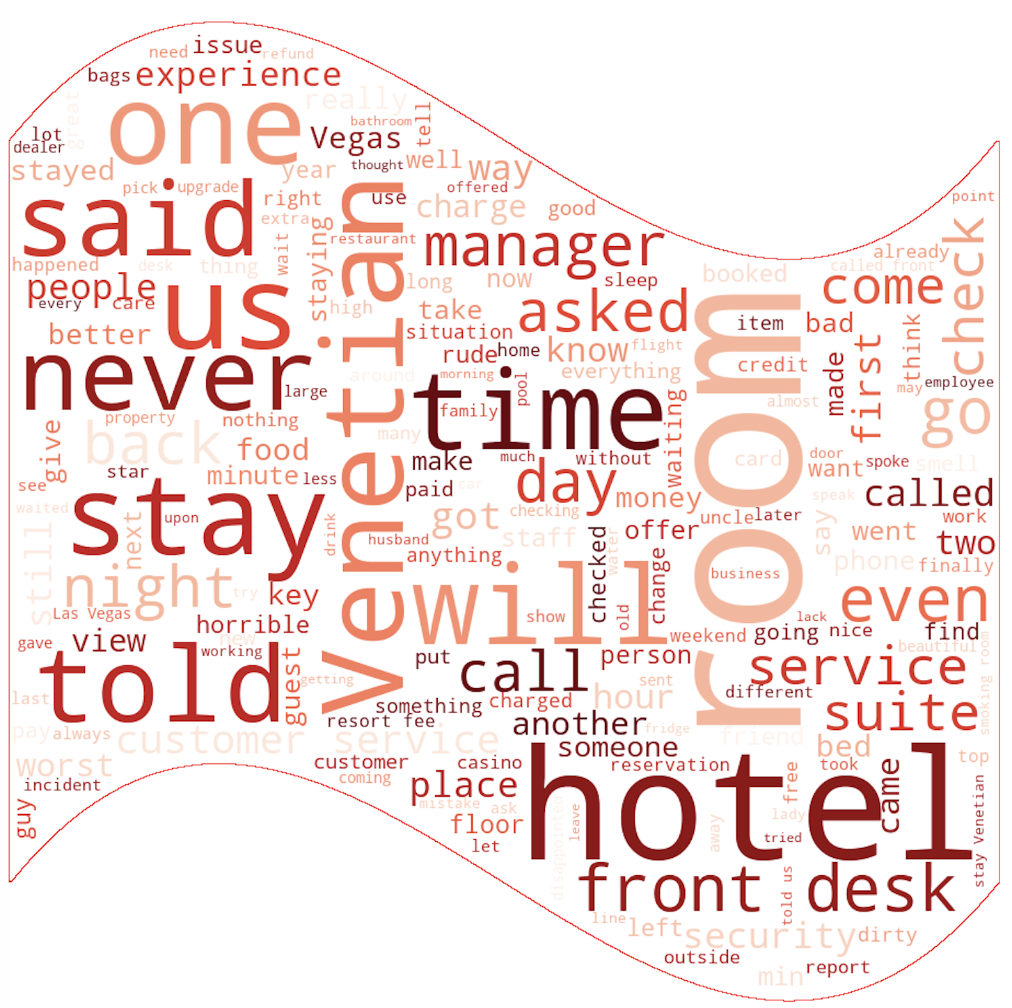
Customer Rating Review - 2
Encoding Scheme:
Color: positive and negative stars
Length: the values for 15days on positive and negative
Could word: the main text from customers‘ comments

Slide 14
Analytical Task – User To help users to intuitively understand the differences between different restaurants, and to choose the one that suits their taste according to its location and preferences.
Visualize the location of restaurants around the user. (Example : Las vegas)
Map
Display high dimensional data of all restaurants around the user, such as price, taste, rating stars.
Parallel Coordinates
User
Visualize positive and negative reviews for each restaurant.
Word cloud
Visualize the data to help users compare multi-variables for specific restaurants.
Radar chart

Slide 15
Data Processing – Text Data Cleaning
Original
Tokenization
Remove stop words
Porter Stemmer
They greeted us with warm smiles as we came in.
[they,greeted,us,with,warm,smiles,as,we,came,in]
[they,greeted,we,warm,smile,come]
[they,greet,we,warm,smile,come]

Slide 16
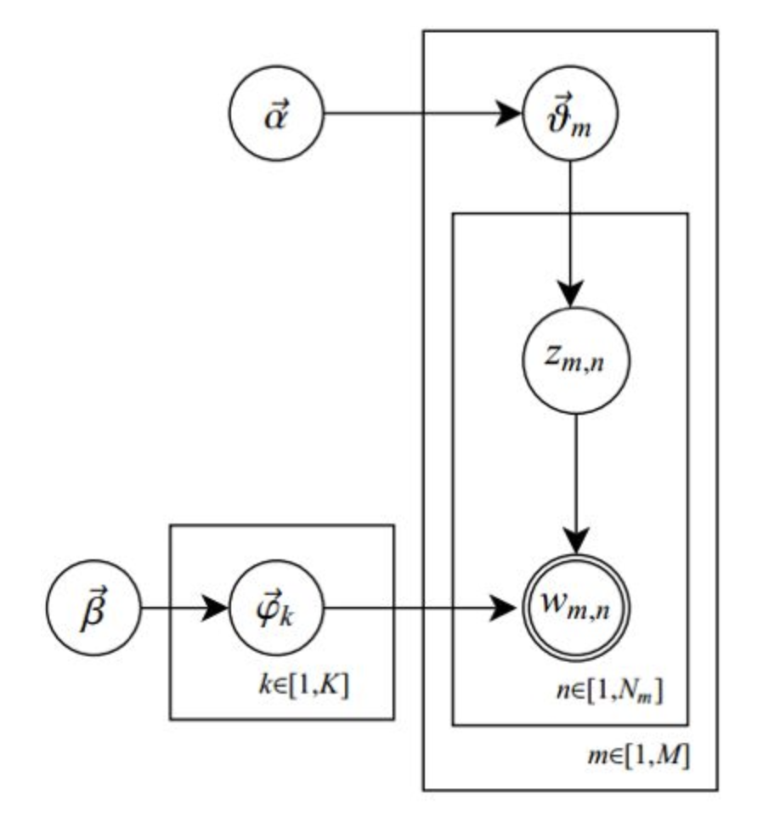
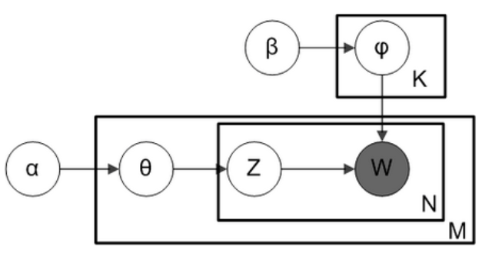
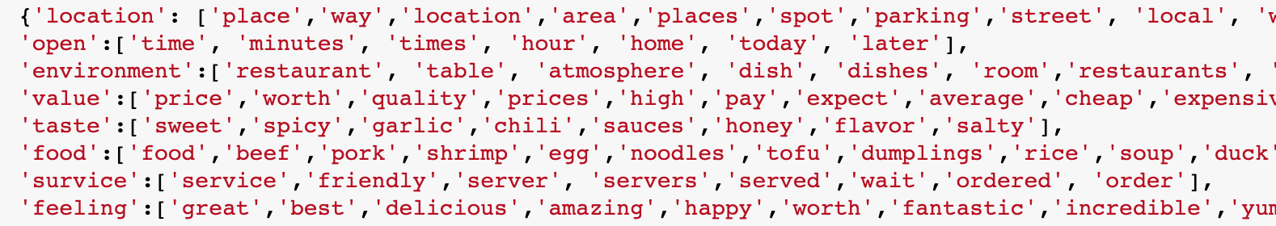
LDA
Bag-of-Words Model
Statistical Distribution
Gamma, Beta, Binomial, Dirichlet,
Multinomial, conjugate prior
MCMC & Gibbs Sampling
Outcome:
8 topic with n words
James Huang, Stephanie Rogers, and Eunkwang Joo. Improving restaurants by extracting subtopics from yelp reviews. iConference 2014 (Social Media Expo), 2014.

Slide 17
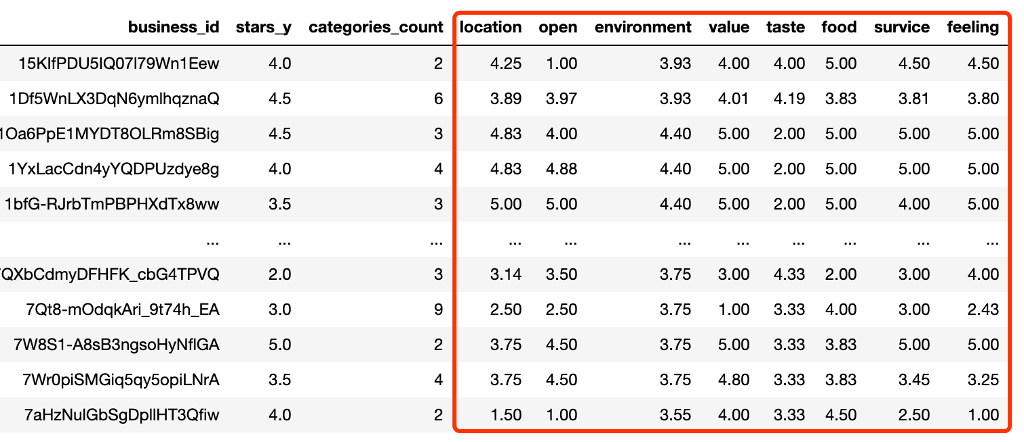
Data Processing
Business_id | review | stars
Ijcu82mHv | “They greeted us with warm smiles as we came in. Pork is good." | 3
Ijcu82mHv | "I like the food here and it is fresh and delicious, and its location is not far away for me." | 4
(3+4)/2=3.5

Slide 18
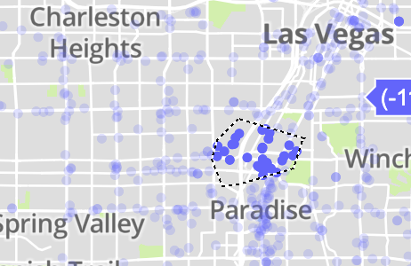
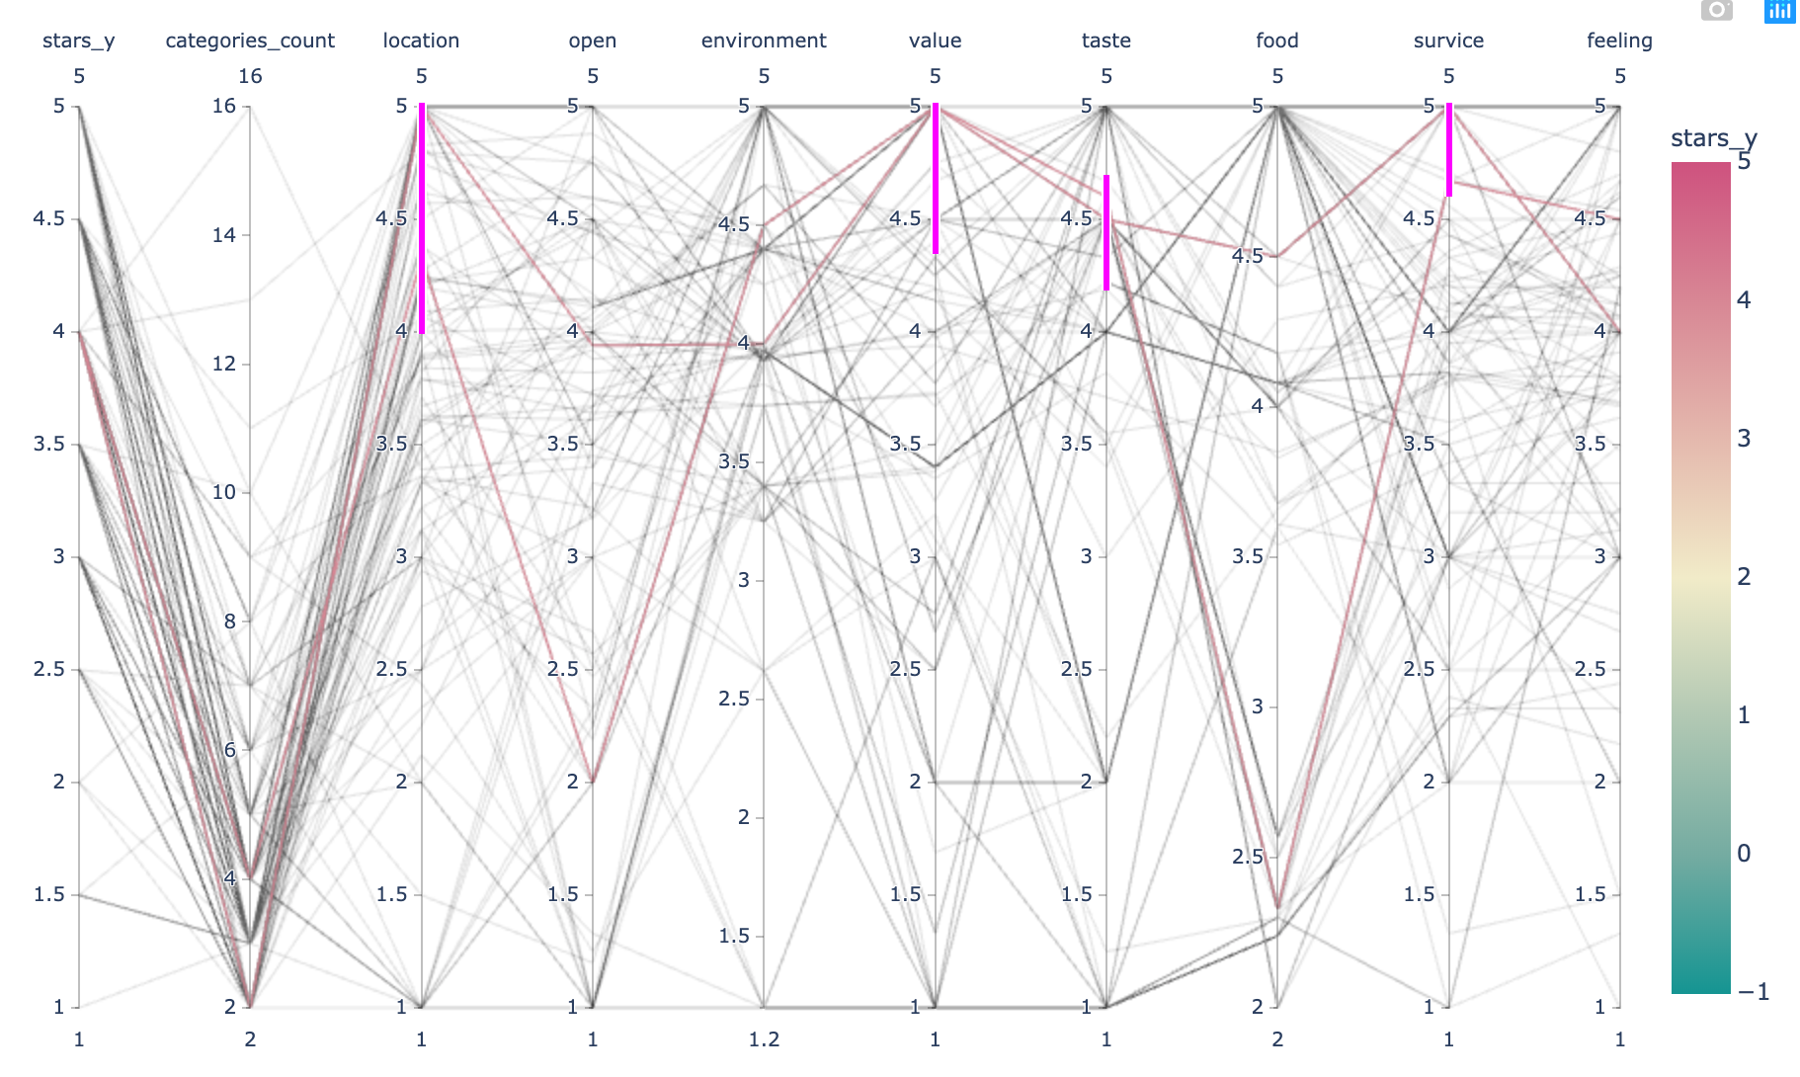
Rough Selection
Map
Encoding Scheme:
Map and Parallel coordinates
Colors of each line means star of this business
Red represents 5 stars and green represents 1 star
Parallel Coordinates

Slide 19
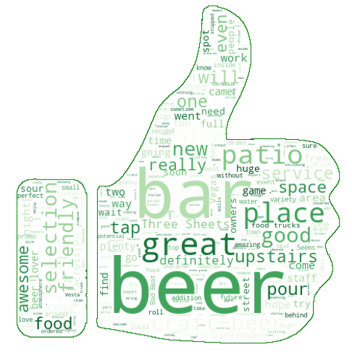
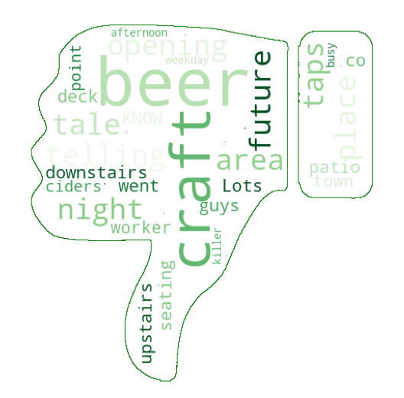
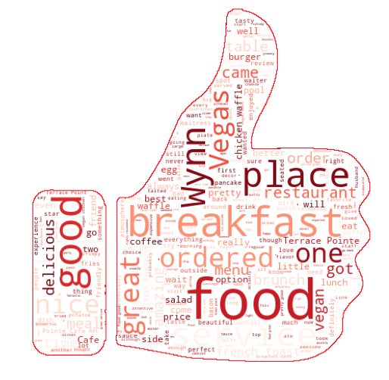
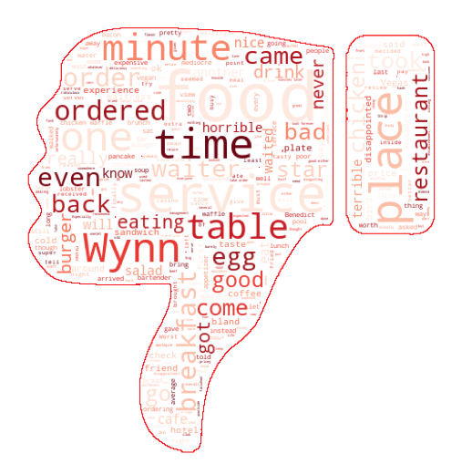
Detail Comparison (Reviews)
Restaurant 1
Encoding Scheme:
Size of text : Frequency
Shape : Thumbs-up means positive, and thumbs-down means negative.
Color represents each restaurant
Findings:
Display keywords such as menu and mood.
Restaurant 2

Slide 20
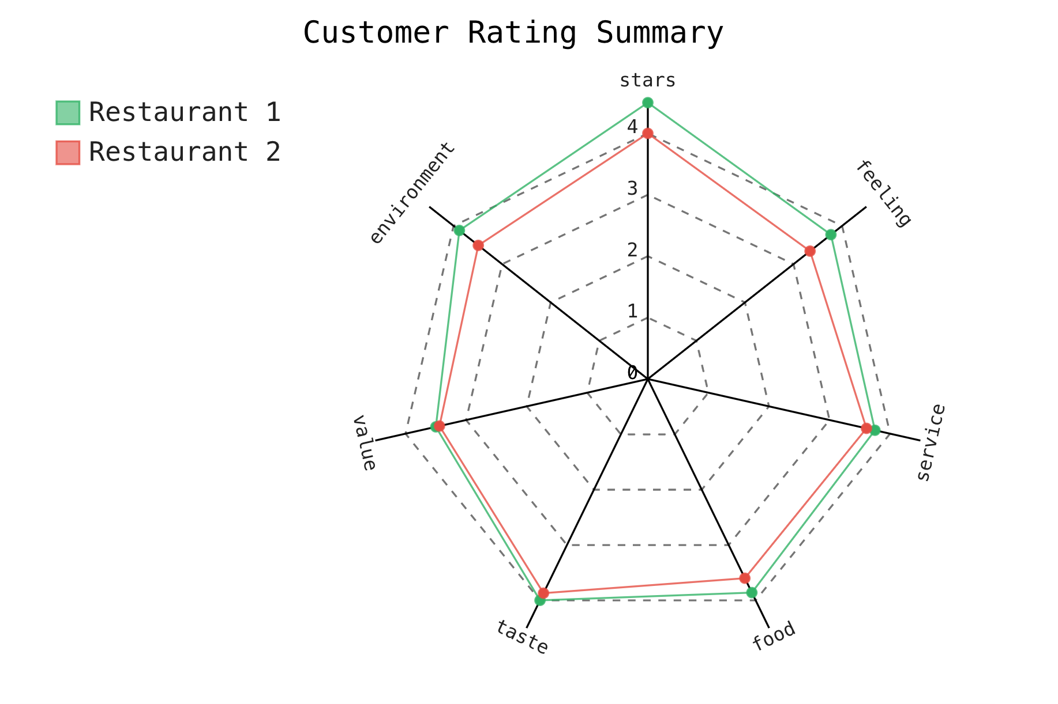
Detail Comparison (Multi Dimensions)
Encoding Scheme:
Colors represent each restaurant (red and green), same with wordcloud color
Findings:
Compare overall information for multi-variables easily

Slide 21


Business owners
Users
Monitor the flow of customers interactively with number of check-ins a day via HTML.
Display the crowdedness for the business owners to gain insights about when was the busiest day and when was not.
Monitor the trend of stars and reviews by customers every 15 days for 1.5 years.
Check the nearby restaurants in a map and make rough choices from various decision factors such as location, taste, stars.
Check positive and negative review words, frequently commented.
Compare the restaurants easily with a radar chart at first glance.
Future Work
Implement more interactive visualization for users
- Connect the filtered result of parallel coordinates
to radar chart and wordcloud
Conclusion

Slide 22

Thank You

